Slide 1
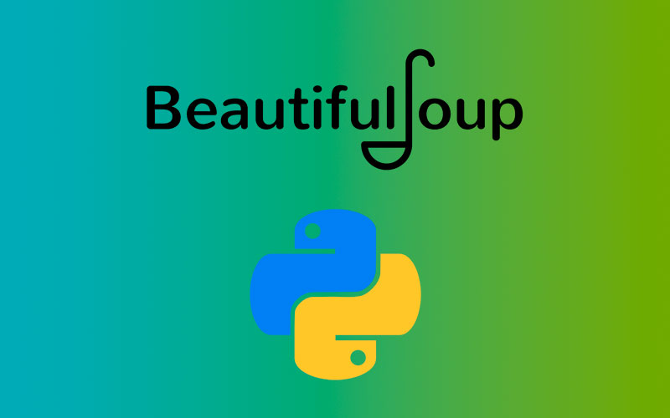
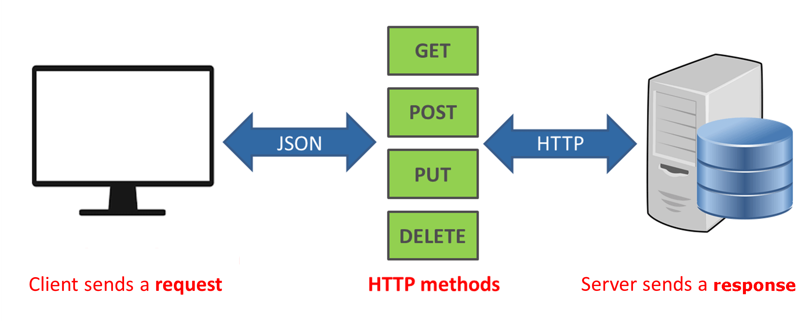

API’S, Selenium, BeautifulSoup… Depression
2/22/23

Slide 2
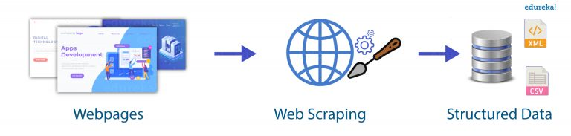
WebScrapping
What is it?
The process of automatically extracting data from websites. It can involve using a programming language (python) to extract data, using an automated browser(Selenium), or using software to get this done.
Pro’s:
Access to more data: Since you’re doing the scrapping, you can gather whatever you want if accessible.
More control over data: APIs may have limitations on what data can be accessed. Sites like Kaggle might not give you what you specifically want.
Cost-effective: Other ways to gather data might cost money. The only thing WS costs you is…. Time
Con’s:
Legal and ethical concerns: Some websites might make it illegal to scrape from them. They can ban you from using their services or it can even bring you legal trouble. Scrapers have to check therobots.txt files of each website to see what they're allowed to do.
Technical challenges: Some websites might make it difficult to scrape from their sites. Scrapers have to learn a lot of technical skills to work around this.
Data quality issues: Data can come back incomplete, inaccurate, or inconsistent, due to variations in website design and structure
All for nothing: Websites consistently change their sites so a webscraper might put in a lot of work to scrape data, and it might never work again.
This Photo by Unknown Author is licensed under CC BY-SA-NC

Slide 3
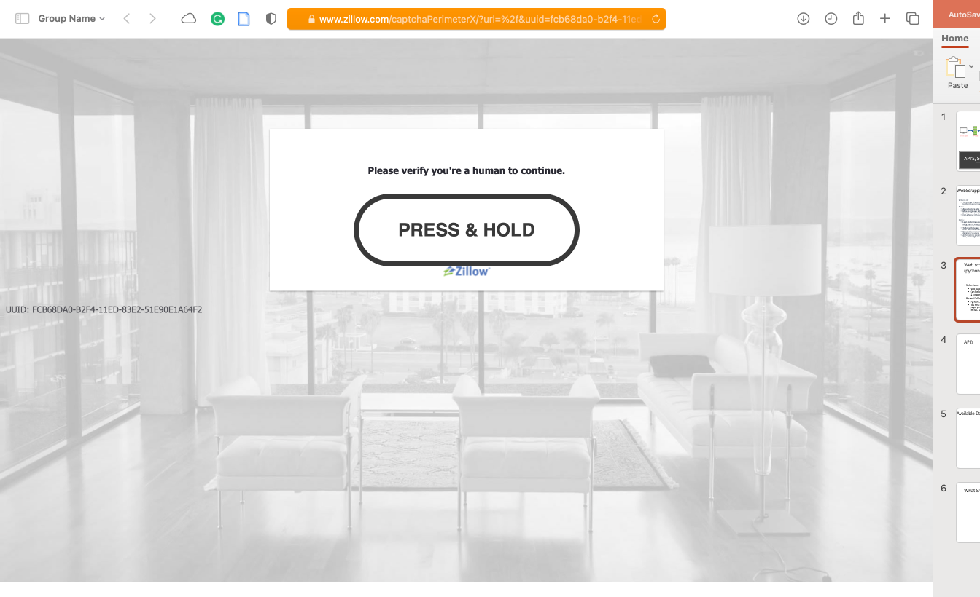
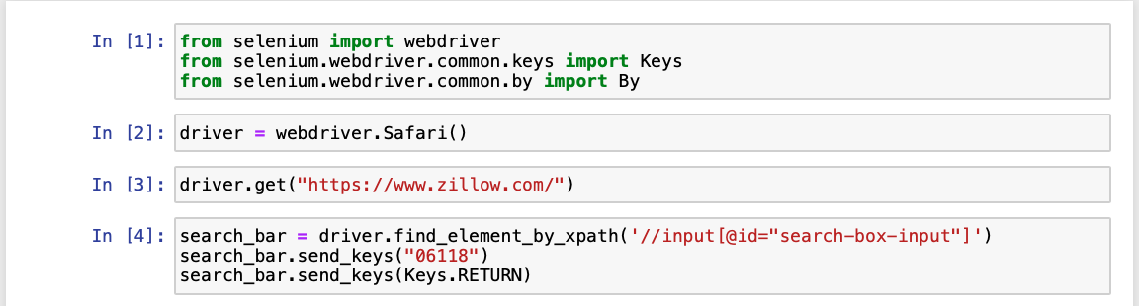
Web scraping (Selenium + BeautifulSoup (python))
Selenium:
web automation tool that is commonly used for web testing and web scraping
Can help in web scraping to bypass some tests websites may use to avoid bots & scrapers.
BeautifulSoup:
Python Library used for web scraping
You first make a request to a web page. Once you have the HTML code for the page, you can extract the specific pieces of data that you're interested in (HTML Tags)

Slide 4
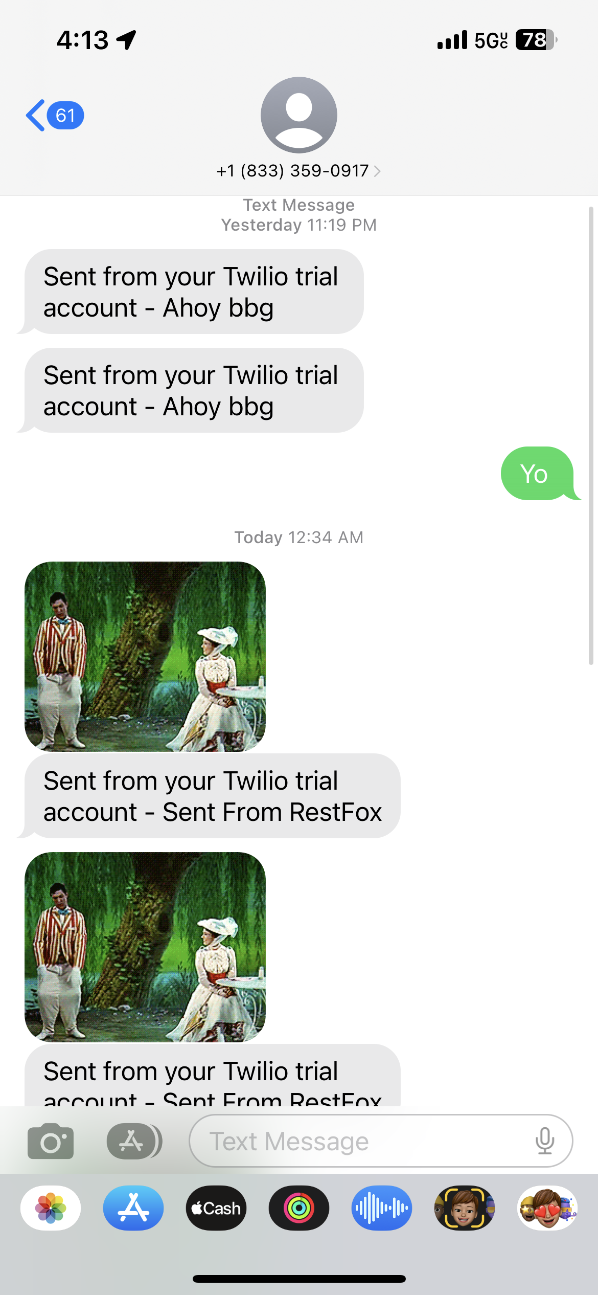
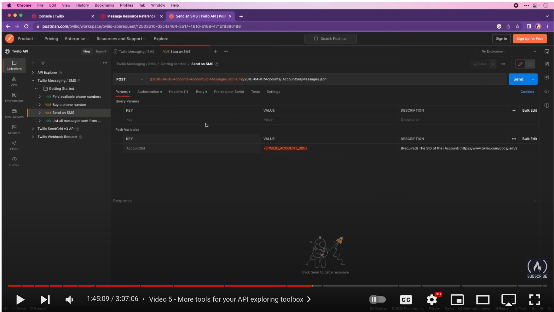
API’s
APIs can gather data by providing a standard way for one application to request and receive data from another application or web service..
By using an API, developers can avoid the time and effort required to build a web scraper. APIs provide a structured and standardized way to access data, making it easier to integrate with other software.

Slide 5
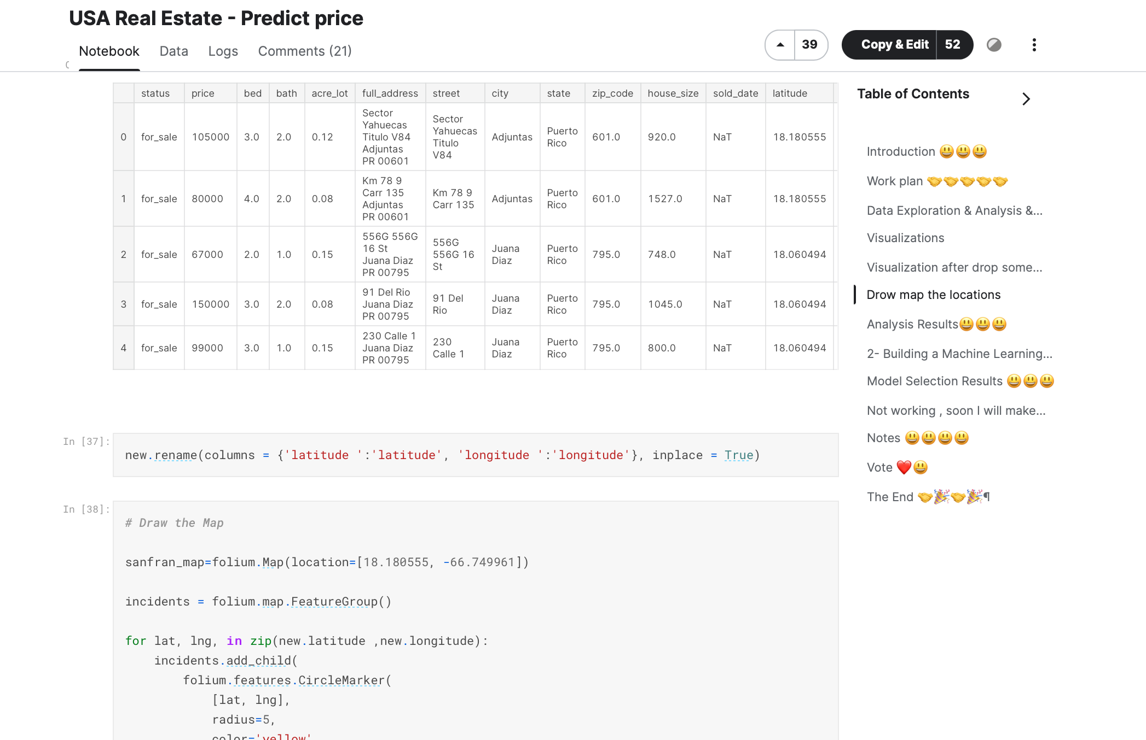
Available Data (Locational Index & Kaggle)
Kaggle: a platform that provides a community of data scientists and machine learning practitioners with tools to share and collaborate on data projects. The platform offers: data hosting and sharing, code sharing, competitions, and courses to help users develop and improve their data science skills.

Slide 6
Questions: What Should I do
The Zillow Api is extremely hard to navigate… Some reddit users even mentioning it impossible to use useful data and rapidapi has a cap of 20 results per request (limit of 15 request… now). Should I give up and try to use selenium like I originally intended?
Other than this… Does any have any experience with Selenium and web scrapping to give me tips? Zillow already knows I’m using a bot lol.

